Slide 1
FRI-based Recursion with a Groth16 Wrapper
VanhGer

Slide 2
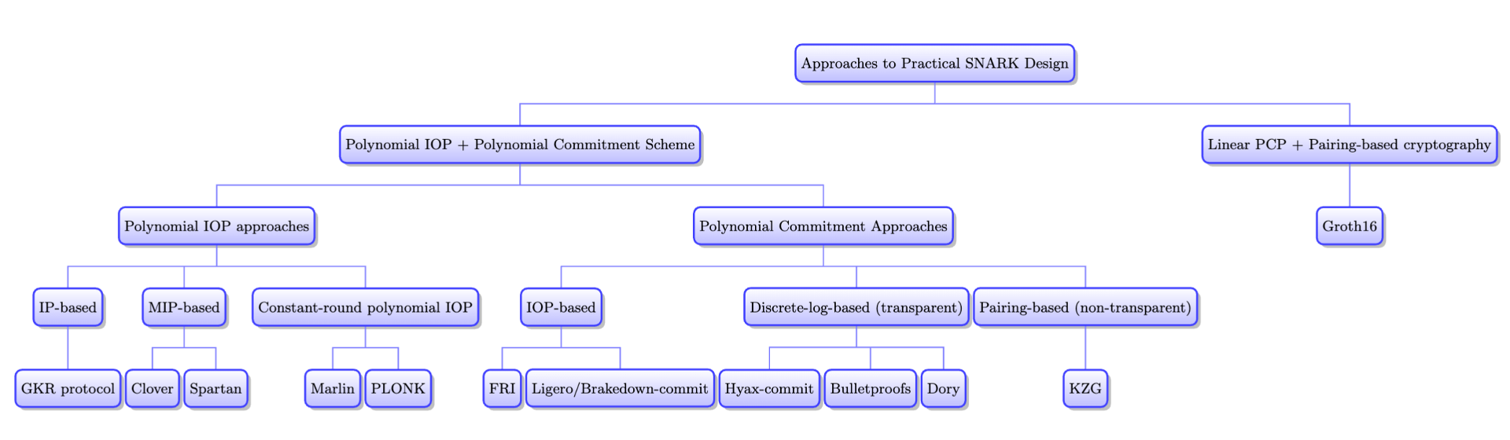
Overview

Slide 3
Overview
FRI-based recursion with a Groth16 Wrapper is an emergent pattern across Polygon, RISC Zero, zkSync, and others.
RISC Zero | Polygon zkEVM (Hermez) | zkSync (Boojum)
FRI + Groth16 | FRI + KZG | FRI + KZG

Slide 4
FRI WITH GROTH16

Slide 5
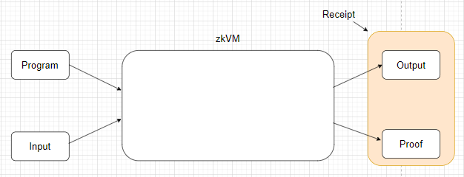
FRI with Groth16
What is ZkVM

Slide 6
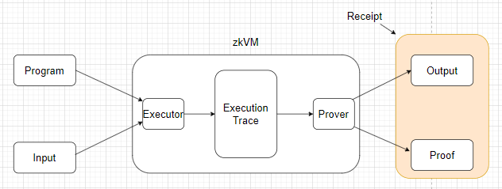
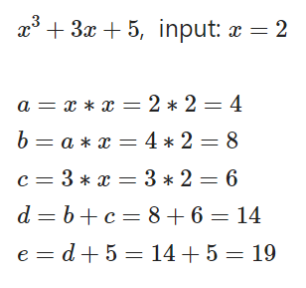
FRI with Groth16
What is ZkVM

Slide 7

FRI with Groth16
What is ZkVM
Considerations:
Prover time
Proof size
Parallelizability
Decentralizability

Slide 8
FRI with Groth16
Prover Time:
Continuations
Before continuations: limit: 16 million machine instructions.
After continuations: no limit ~ 10 billion machine instructions.

Slide 9
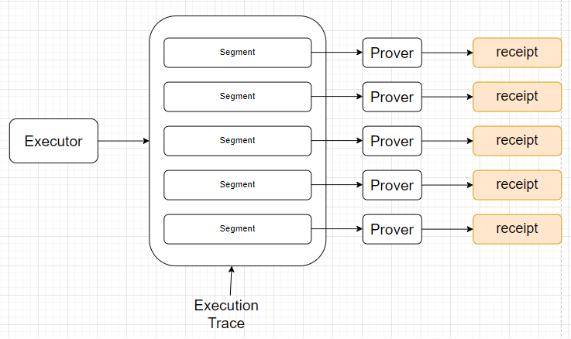
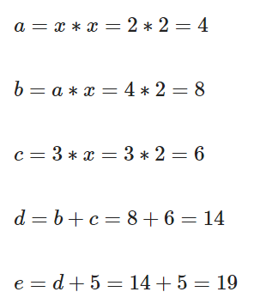
FRI with Groth16
Continuations
Part1: Flat receipt
Segment

Slide 10
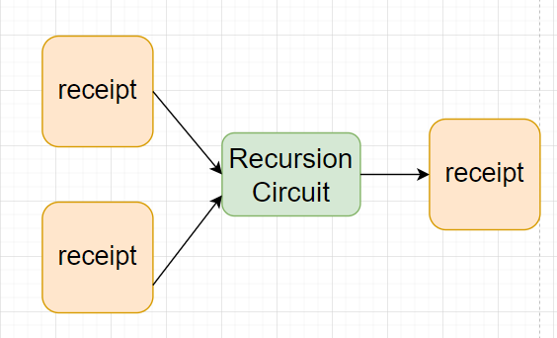
FRI with Groth16
Continuations
Part2: Succinct receipt
Recursive proving

Slide 11
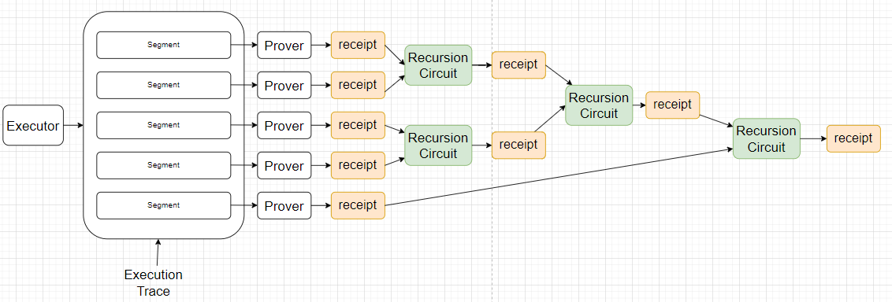
FRI with Groth16
Continuations
Part2: Succinct receipt

Slide 12
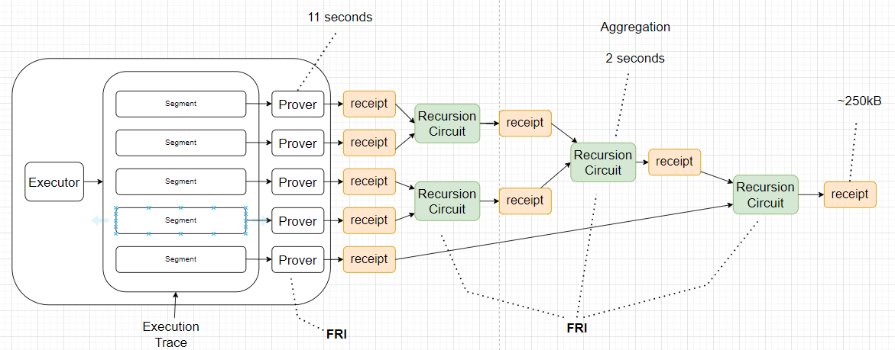
FRI with Groth16

Slide 13
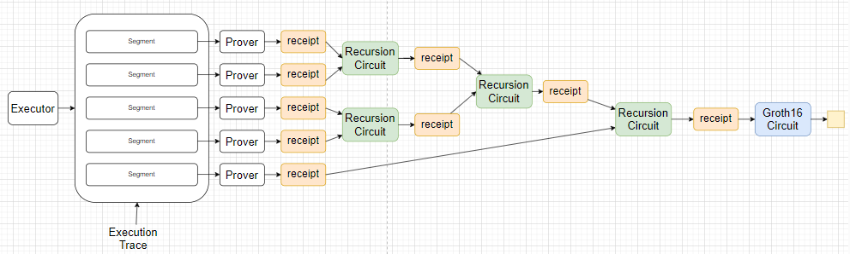
FRI with Groth16
Proof size
Using SNARK: Groth16 to wrap the proof -> Proof size: ~ 100 bytes.
Prover time: 40 seconds

Slide 14
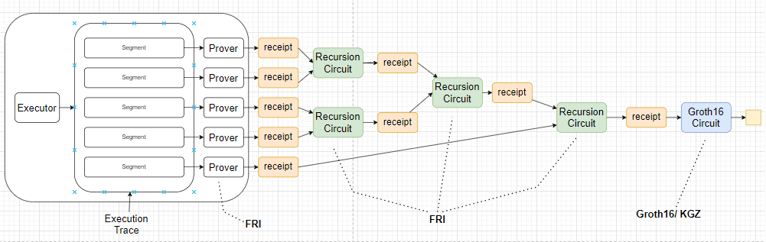
FRI with Groth16
The Emergent Pattern

Slide 15
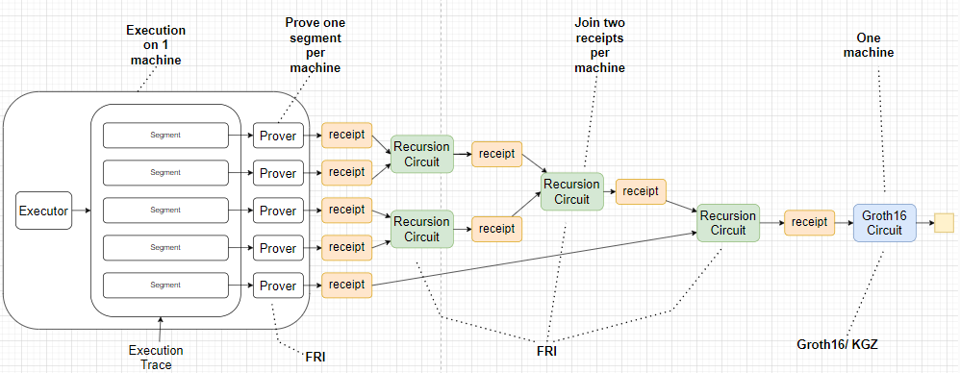
FRI with Groth16
The Emergent Pattern
Parallelizability

Slide 16
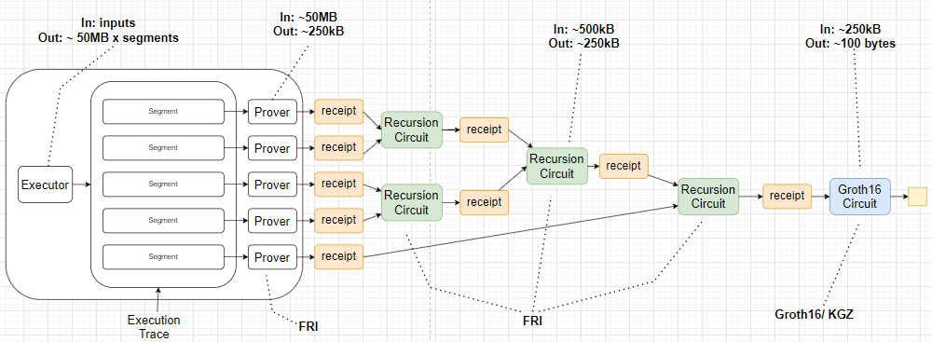
FRI with Groth16
The Emergent Pattern
Decentralizability

Slide 17
Thank for your listening

